Slide 1
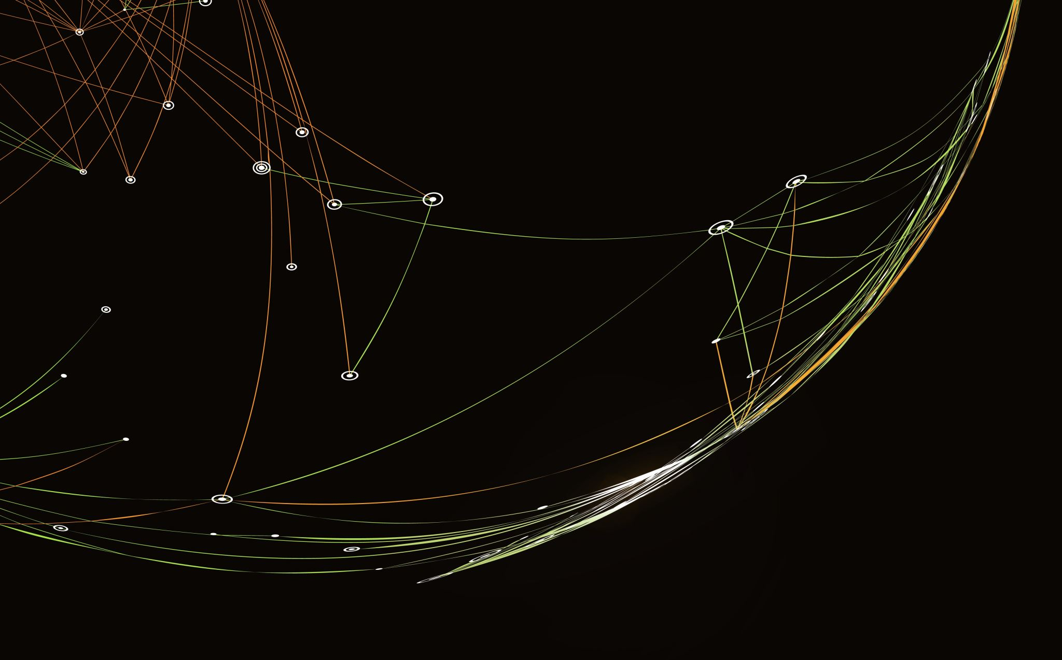
Telecom Churn Analysis
By group

Slide 2
Project Problem Statement:
The rise of competitive offerings in the telecommunication industry has led to an escalating rate of customer churn, wherein subscribers opt to discontinue their services. Such churn not only disrupts consistent revenue streams but also incurs additional acquisition costs for the companies to secure new customers. Predicting customer churn before it occurs can facilitate targeted retention strategies. Given a dataset encompassing customer usage patterns, payment history, and demographics, the challenge is to develop a predictive model that can efficiently and accurately identify potential churn candidates.
Project Objectives:
Data Preprocessing: Refine the raw dataset by handling missing values, outliers, and any inconsistencies
Correlation Analysis: Assess the relationship strength and direction between 'Churn' and other variables within the dataset, identifying key attributes
Data Visualization: Create insightful visualizations that elucidate demographic trends, payment behaviors, and service usage patterns
Predictive Modeling: Employ and evaluate multiple machine learning algorithms, including:
Logistic Regression: Due to its suitability for binary classification problems.
Decision Trees and Forests: To capture non-linear relationships and attribute importance.
K-Nearest Neighbors (KNN): Given its capacity to identify potential clusters within data.
Naive Bayes: Considering its efficiency in dealing with large datasets.
compare the performance metrics (like accuracy, F1-score) of these models to determine the most efficacious algorithm for churn prediction.
Dimension Reduction and Clustering: Utilize techniques like PCA (Principal Component Analysis) to reduce data dimensions, making modeling more efficient, followed by clustering methods to uncover potential hidden patterns or customer segments within the data.
Association Rules: Association rules aim to uncover relationships between seemingly unrelated items, revealing hidden patterns in datasets. They answer the question, "If a customer buys X, what's the likelihood they'll also buy Y?"
Neural Network: Harness the computational power of neural networks, ensuring the capture of intricate patterns within the data that traditional algorithms might overlook.

Slide 3
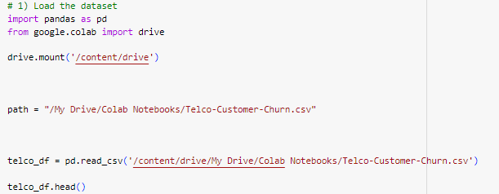
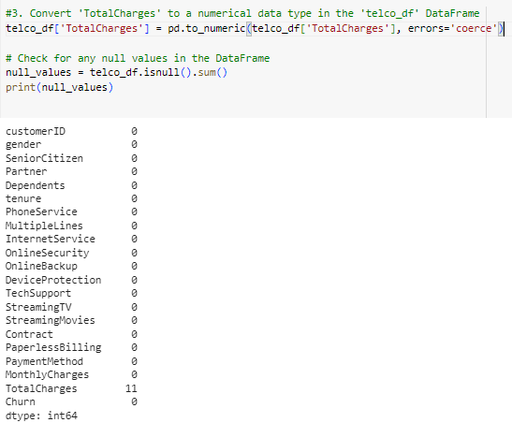
DATA LOADING
Read the Data: We will first load the chosen dataset. We then check the data types of all the columns.
After looking at the output, we can say that there are 11 missing values for Total Charges. Let us replace remove these 11 rows from our data set.

Slide 4
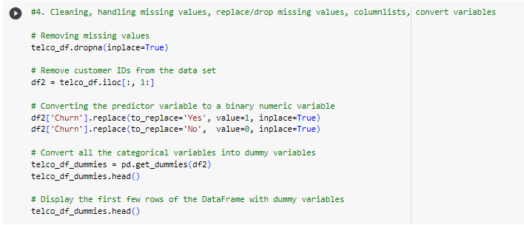
DATA CLEANING/PRE-PROCESSING
The dataset used in this project contains 21 columns and 7,043 rows. The first step in the data cleaning process was to remove any missing values in the dataset.
convert all categorical variables into dummy variables and convert churn predictor variable to binary numeric value.

Slide 5
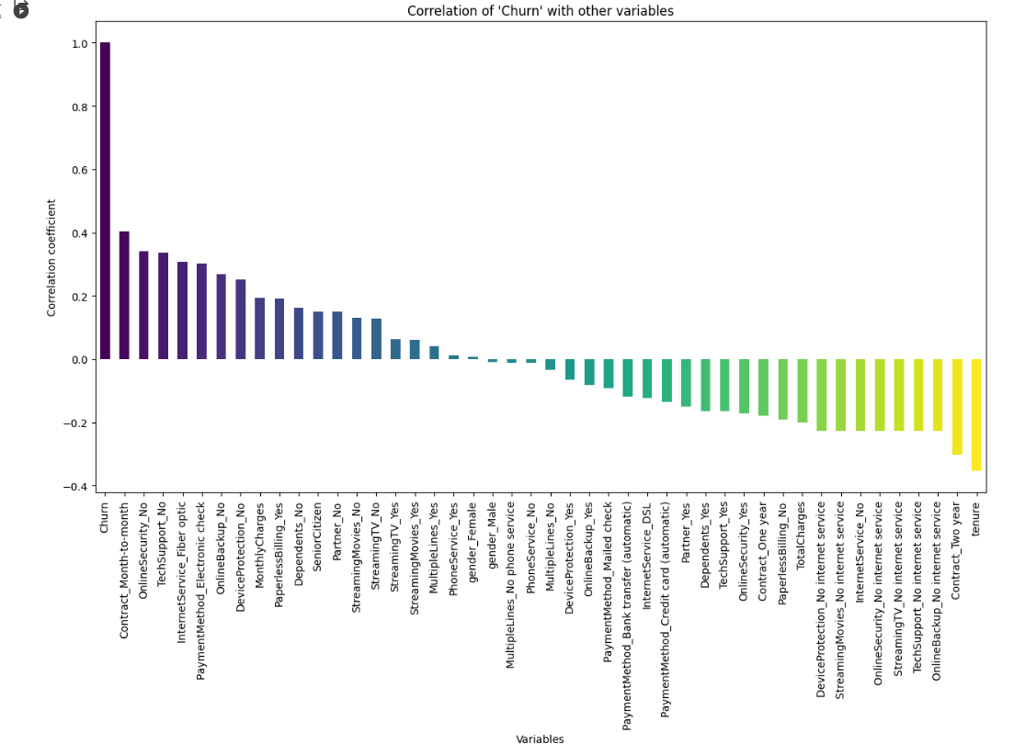
CORRELATION OF CHURN WITH OTHER VARIABLES
Month to month contracts, absence of online security and tech support seem to be positively correlated with churn. While, tenure, two years contracts seem to be negatively correlated with churn.
Interestingly, services such as Online security, streaming TV, online backup, tech support, etc. without internet connection seem to be negatively related to churn.
We will explore the patterns for the above correlations below before we delve into modelling and identifying the important variables.
Observations
No Strong Correlation among variables
Moderately Strong Positive Correlation – Contract_Month to month, Online Security_No, Tech_Support_No, Internet_Service_Fiber Optic_No, Payment Method_Electronic Check_No, Online_Backup_No,
Moderately Strong Negative Correlation - Contract Two Year, Tenure
Rest are lowly correlated

Slide 6
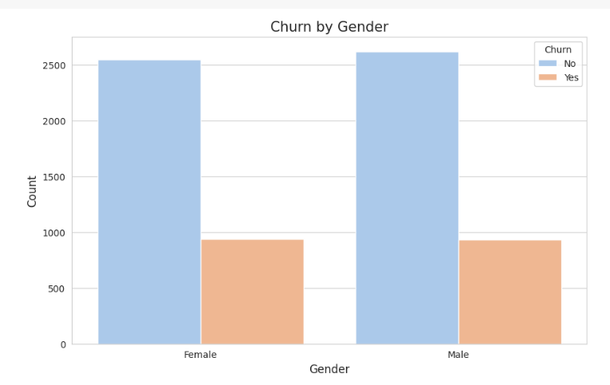
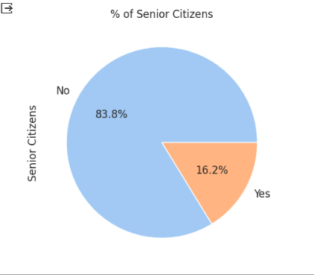
DATA VISULAIZATION
We performed the Data Visualization on the data to get the insights about the customer churn based on the required factors.

Slide 7
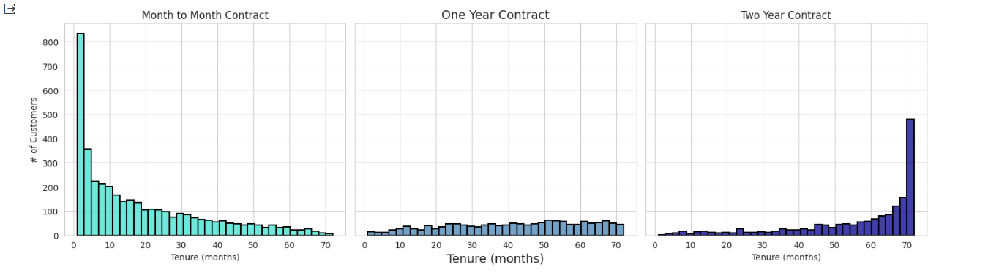
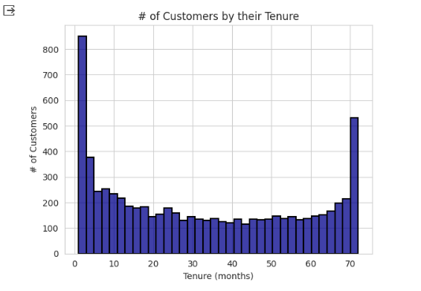
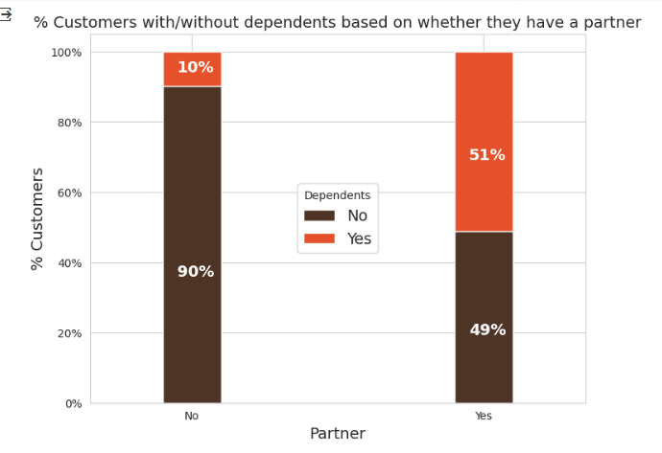
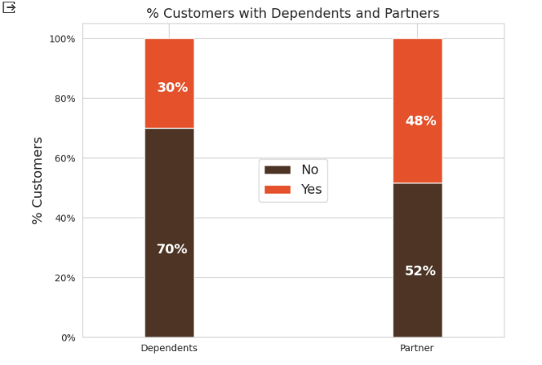

Slide 8
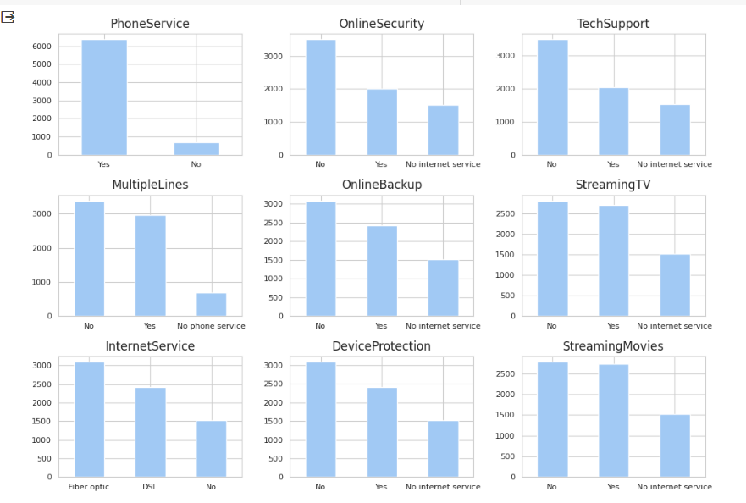

Slide 9
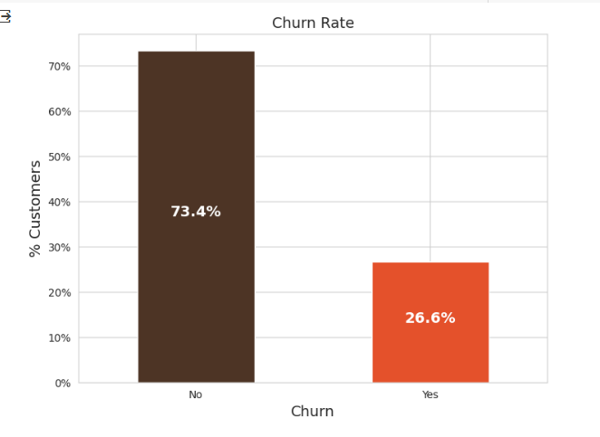
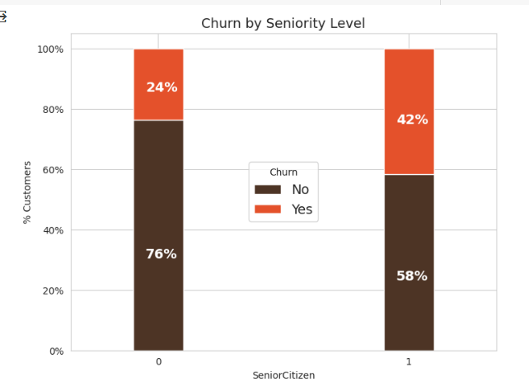
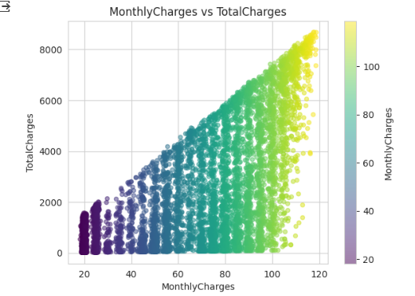
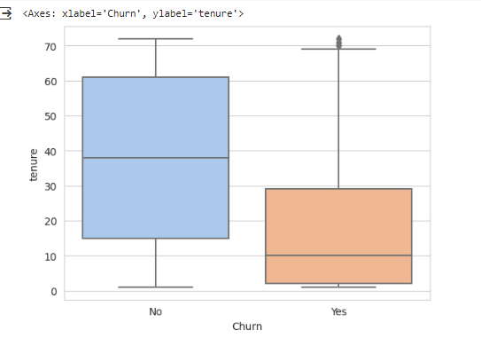
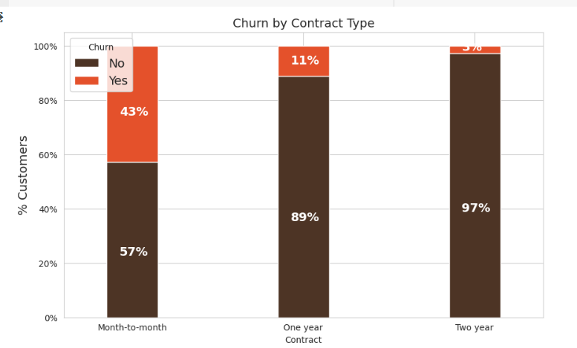

Slide 10
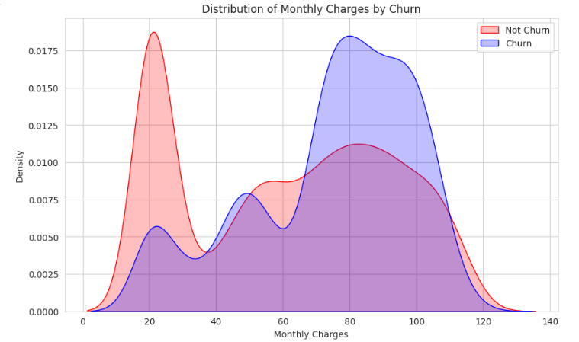
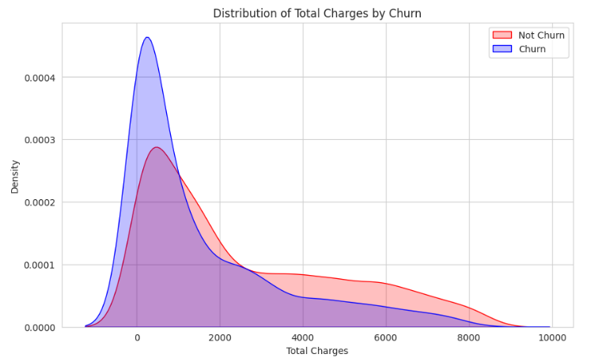

Slide 11
PRIMARY MODELS FOR ANALYSIS
When tackling a classification problem, there is no one-size-fits-all algorithm. We explore various models and ultimately select the most suitable one based on accuracy and F1 score, aiming for the highest achievable performance.
In our evaluation process, we considered the following models:
Logistic Regression
Decision Tree Classifier
Random Forest Classifier
K-Nearest Neighbors (KNN)
Naive Bayes Classifier
After careful assessment, we determined the best-performing model to address our specific problem and maximize both accuracy and the F1 score.

Slide 12
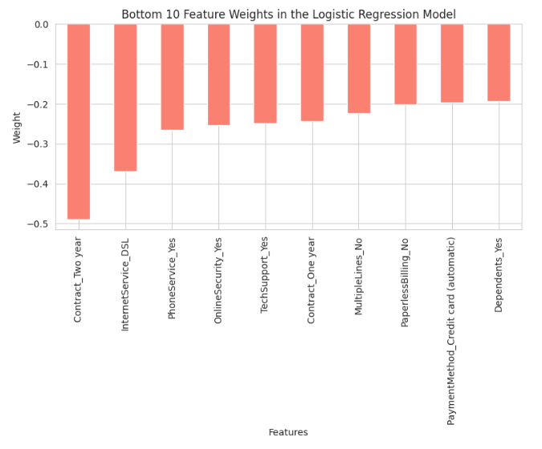
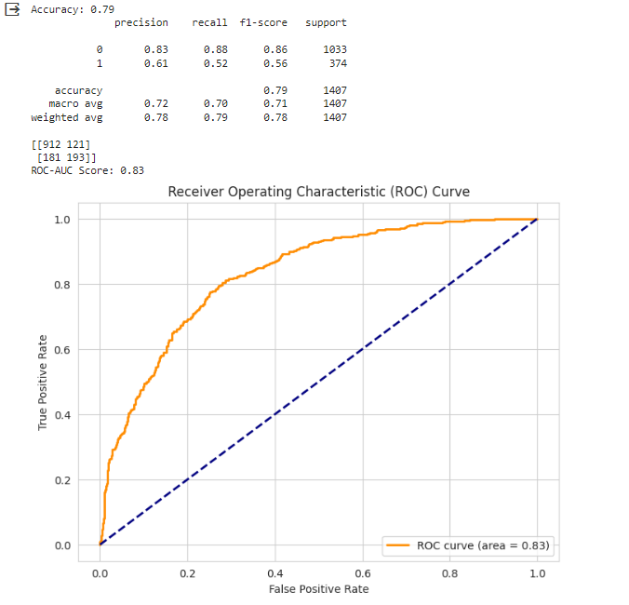
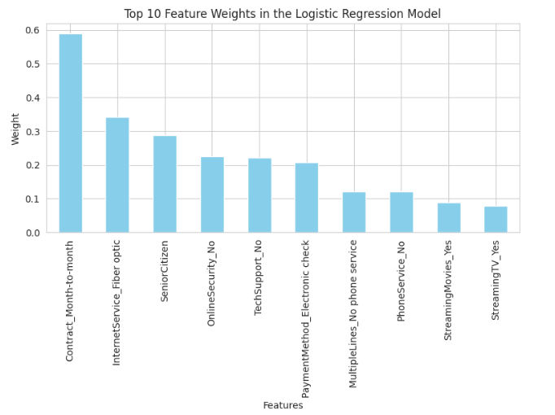
LOGISTIC REGRESSION

Slide 13
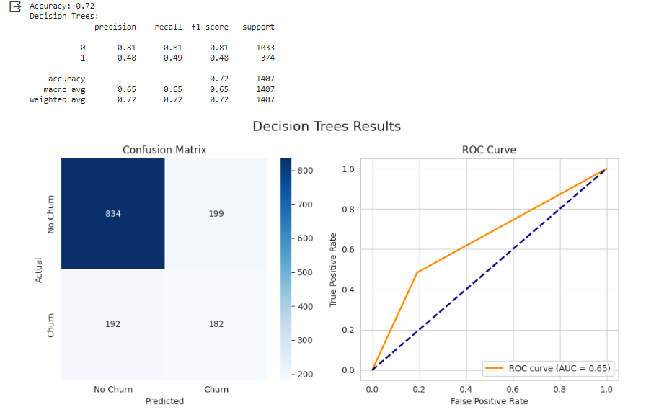
DECISION TREE

Slide 14
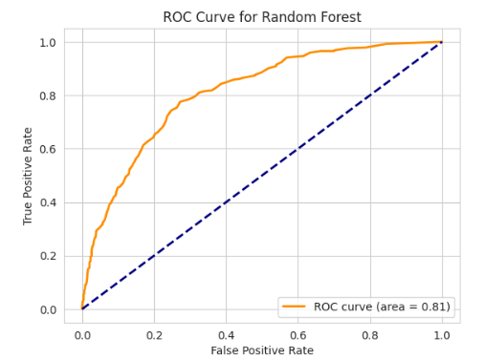
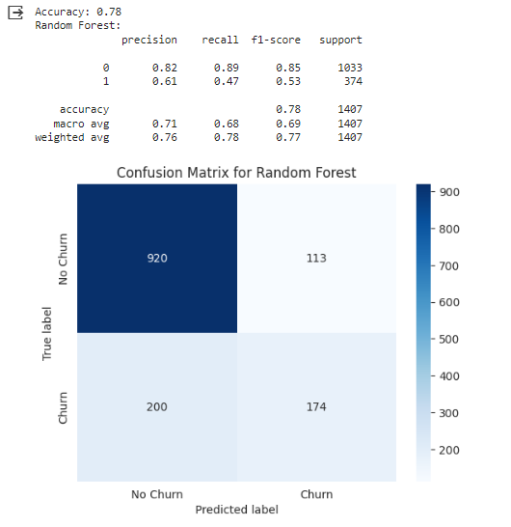
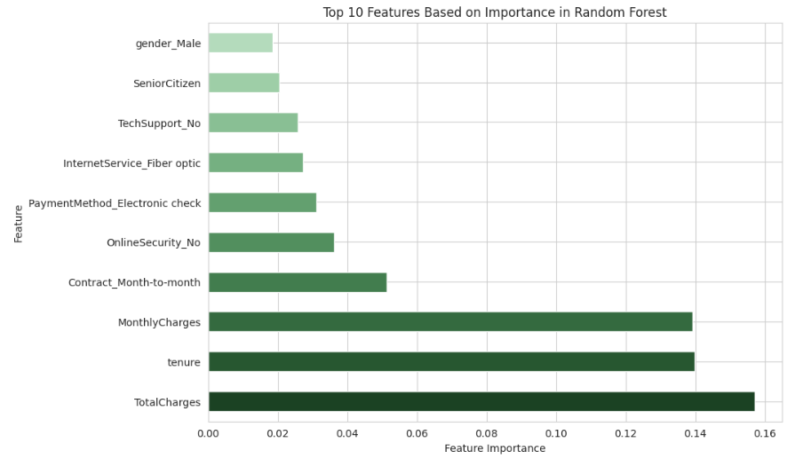
RANDOM FOREST

Slide 15
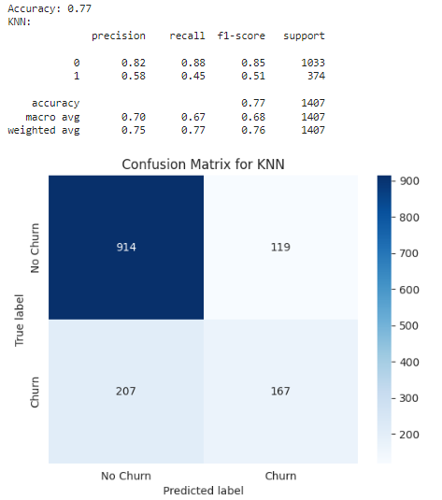
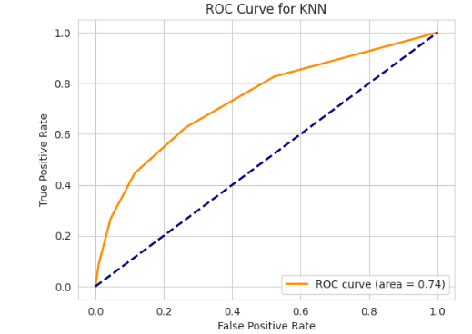
KNN MODEL

Slide 16
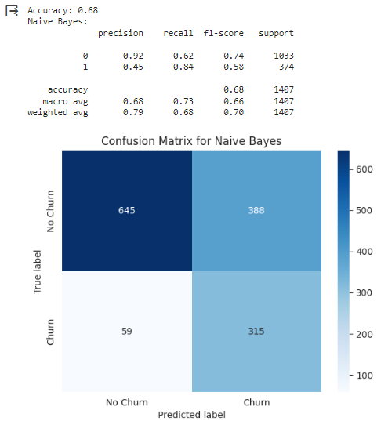
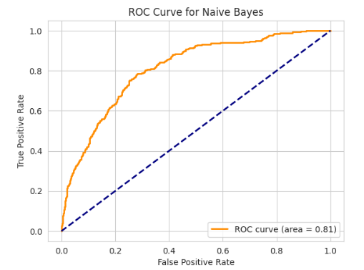
NAÏVE BAYES CLASSIFIER

Slide 17
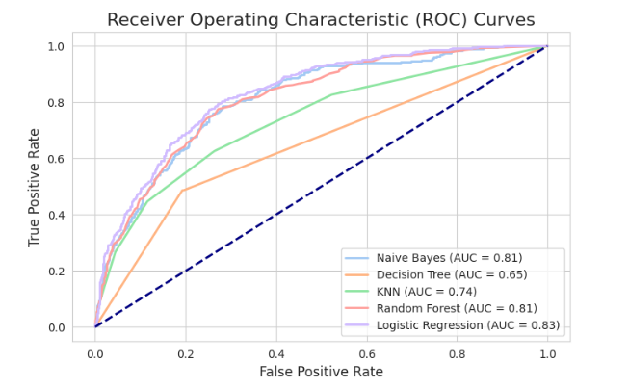
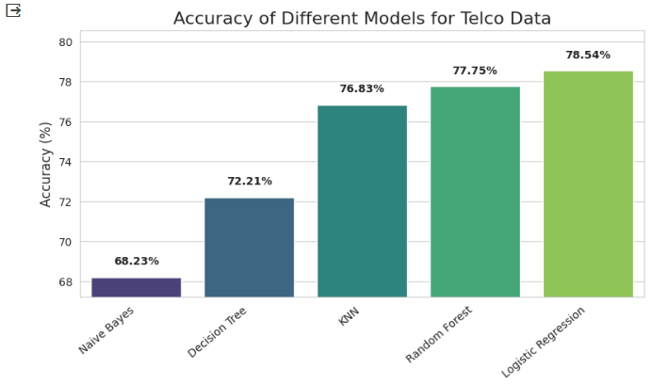
COMPARISON OF THE MODELS

Slide 18
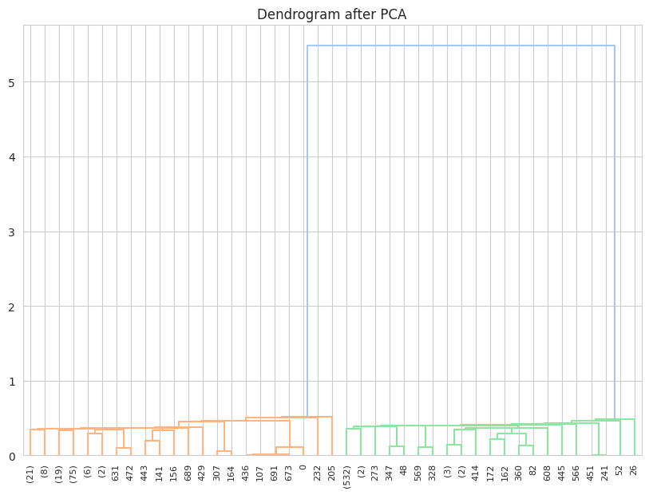
DIMENSIONAL REDUCTION AND CLUSTERING: DENDOGRAM

Slide 19
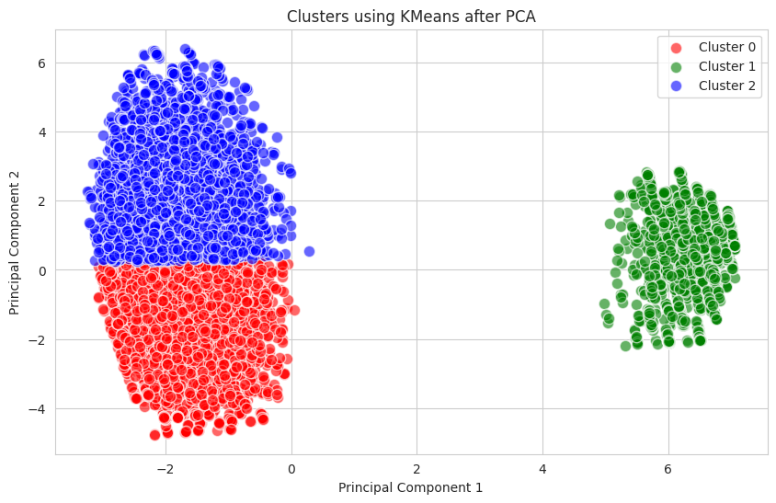
DIMENSIONAL REDUCTION: CLUSTERING
Red Cluster:
Younger customers
Many with partners, fewer with dependents
High phone and internet usage
Low online security
Moderate monthly charges
Highest churn rate
"Young & Risky"
Green Cluster:
Younger customers
More with partners and dependents than Red
Slightly less internet usage
Lower monthly charges
Lowest churn rate
"Young & Stable"
Blue Cluster:
Least senior citizens
Highest with partners and dependents
Extensive service usage
Highest spending
Moderate churn rate
"Affluent & Engaged"

Slide 20
INTERPRETATION FOR DIMENSION REDUCTION, CLUSTERING & PCA
Red Cluster Insights:
Contains younger customers (only 17.68% are senior citizens).
Almost half have partners, and slightly over a quarter have dependents.
Most of them use phone services, and a significant portion uses multiple lines.
A substantial number uses the internet, but only about 27% have online security.
The average monthly charge is roughly $64.63, and the average total charge is $2158.76.
The churn rate is relatively high at 27.11%.
Green Cluster Insights:
Similarly, this cluster contains younger customers (17.55% are senior citizens).
A slightly higher proportion have partners compared to the Red cluster, and also a bit higher proportion have dependents.
The service usage profile is similar to the Red cluster but with a lower percentage of internet users.
The average monthly and total charges are $62.82 and $2299.45, respectively.
The churn rate is the lowest among the three at 22.70%.
Blue Cluster Insights:
Has the least proportion of senior citizens among the three clusters.
Contains the highest proportion of individuals with partners and dependents.
Most of them use phone services, and a significant portion uses multiple lines. The internet usage percentage is also the highest among the three.
The average monthly and total charges are the highest among the three clusters.
The churn rate sits in the middle at 24.32%.
From our observations:
The Green cluster seems to be the most stable with the lowest churn rate.
The Red cluster experiences the highest churn rate, suggesting we might need interventions to retain these customers.
The Blue cluster, despite spending the most, also has a relatively high churn rate.

Slide 21
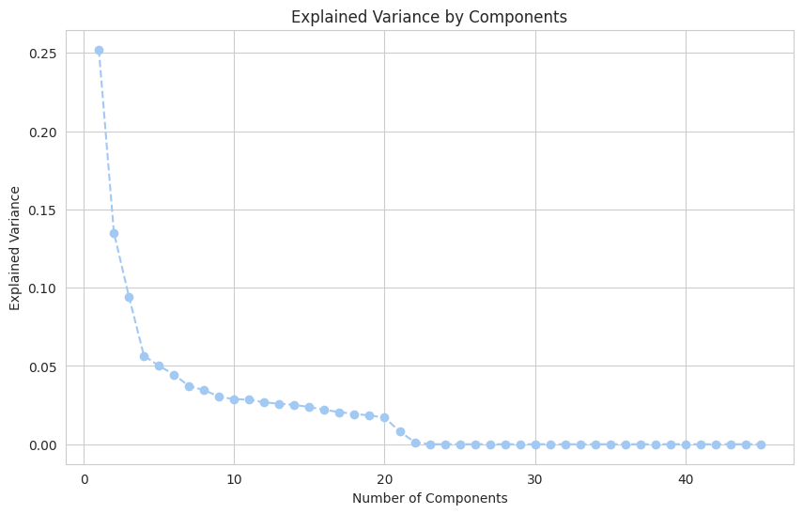
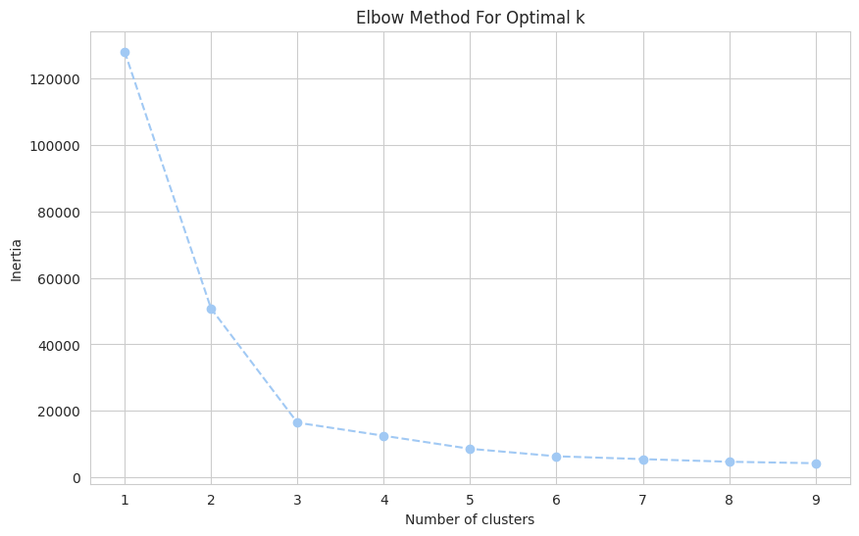
PCA & K-MEANS CLUSTERING
PCA Analysis:
First component captures ~99.99% of variance.
By third component, nearly 100% variance is explained.
Data likely has correlated features; dimensionality reduction is viable.
K-Means Clustering:
Major inertia drop from 1 to 2 clusters.
Significant reduction again from 2 to 3 clusters.
Diminishing reductions in inertia after 3 clusters.
Optimal cluster count: 2 or 3, based on inertia.

Slide 22
ASSOCIATION RULES ANALYSIS & INTERPRETATION
Key Findings (Sampled Data)
- Based on a 10% sample of the data:
74.9% of the users with Fiber Optic internet service prefer a Month-to-month contract.
80.3% of users who opt for Electronic Check payments are on a Month-to-month contract.
Customers combining Fiber Optic with Electronic Check payments are 1.47 times more likely to opt for a Month-to-month contract.
72.3% of users with both Electronic Check payments and Month-to-month contract use Fiber Optic as their internet service.
Association Rule Analysis Overview
- Goal: Identify relationships between customer behavior (features) using transaction data.
- Method: Applied the Apriori algorithm to identify frequent itemsets.
- Metrics Used:
Support: Probability of occurrence of the itemset.
Confidence: Likelihood of Y happening, given X occurs.
Lift: Increase in the ratio of the sale of Y when X is sold.

Slide 23
NEURAL NETWORKS’ INTERPRETATION
Neural Network Model
Objective: To predict customer churn based on various features.
Model Details:
A simple 3-layer neural network.
32 neurons in the first two layers with ReLU activation.
A single neuron in the output layer with sigmoid activation (binary classification).
Adam optimizer with a learning rate of 0.001 was used.
Results:
The model achieved ~98.81% accuracy on the training set by the 10th epoch.
Validation accuracy remained consistent at 72.41% from the 3rd to the 10th epoch.
Observation: Although the model performs well on the training set, the consistent validation accuracy suggests potential overfitting. Consider implementing regularization techniques or adjusting the architecture.
Neural Network Classifier Performance
Objective: To validate the trained model's performance.
Results:
Overall Accuracy: 76%
Precision (of predicting Churn = Yes): 81%
Recall (of actual Churn = Yes instances): 89%
F1-Score (harmonic mean of precision and recall for Churn = Yes): 85%
Confusion Matrix:
True Negatives (Correctly predicted 'No Churn'): 186
False Positives (Incorrectly predicted 'Churn'): 24
False Negatives (Incorrectly predicted 'No Churn'): 44
True Positives (Correctly predicted 'Churn'): 28
Observation: The model is more accurate at predicting customers who don't churn (recall of 89% for 'No Churn'). However, it struggles somewhat with identifying those who do (recall of 39% for 'Churn'). This is reflected in the F1-score, which gives a balanced measure of the model's performance on both classes.

Slide 24
FINDINGS & RECOMMENDATIONS
Major Findings from Data Analysis:
Customer Segmentation: KMeans clustering identified distinct customer groups, enabling targeted marketing.
Churn Association: Fiber optic users show a high association with churn, indicating possible service dissatisfaction.
Service Affinities: Association rules highlight prevalent service combinations, suggesting popular package preferences.
Churn Prediction: Our neural network effectively predicts customer churn with 76% accuracy.
Model Insights: The precision and recall metrics emphasize successful identification of non-churners, though there's room for improvement in identifying actual churners.
Potential Improvements: Continuous feedback from churn-prone segments can provide real-time insights for immediate action.
Recommendations Based on Data Insights:
Tailor Marketing: Design campaigns based on customer clusters from KMeans.
Enhance Fiber Optic Service: Address higher churn among fiber optic users through service improvements or feature additions.
Optimize Service Bundles: Use association rules to bundle popular service combinations, boosting sales.
Targeted Retention: Utilize the neural network's churn predictions to offer loyalty incentives to high-risk customers.
Implement Feedback: Create mechanisms for feedback, especially from potential churners, to understand and address concerns.
Refine Prediction Model: Further develop the neural network model for increased accuracy and actionable insights.

Slide 25
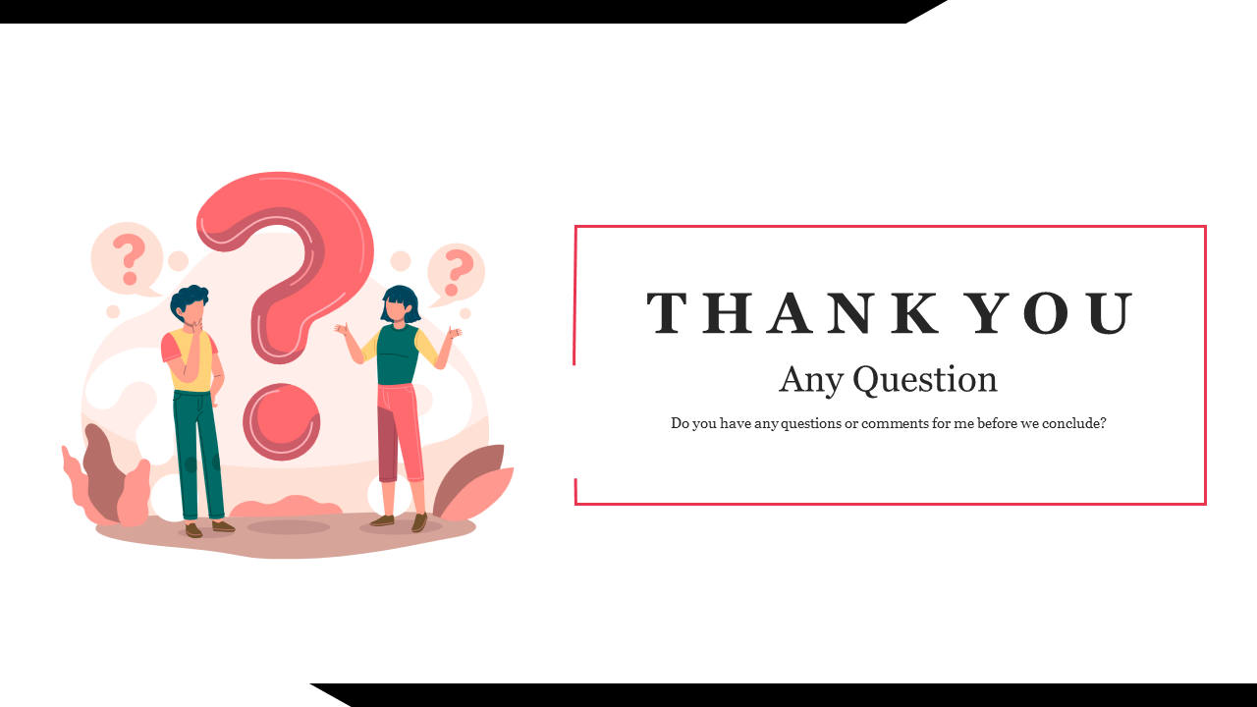
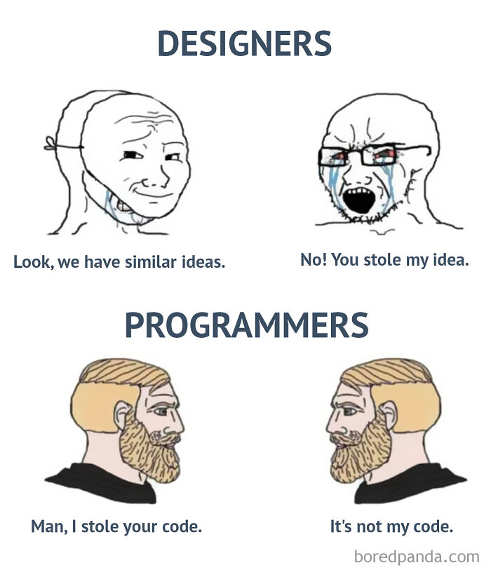
Notes:
Alright folks, let's give a HUGE round of applause to the things I'm sooo grateful for - starting with our beloved colab, which crashed so often it made me nostalgic for dial-up internet.
Oh, our course slides? Their slides are basically bedtime stories for insomniacs.
Shoutout to my groupmates - we did it!
Google, you know all my embarrassing Python errors. GitHub, because why not add one more confusing platform? ChatGPT, my virtual therapist, Kaggle for... stuff.
And let's not forget that random Indian guy on YouTube - his Python lectures? Game-changers. I mean, who needs college anyway?

